Slide 1
Home Policy Presentation
How to Prevent Customer Home Policy Lapsing.

Slide 2
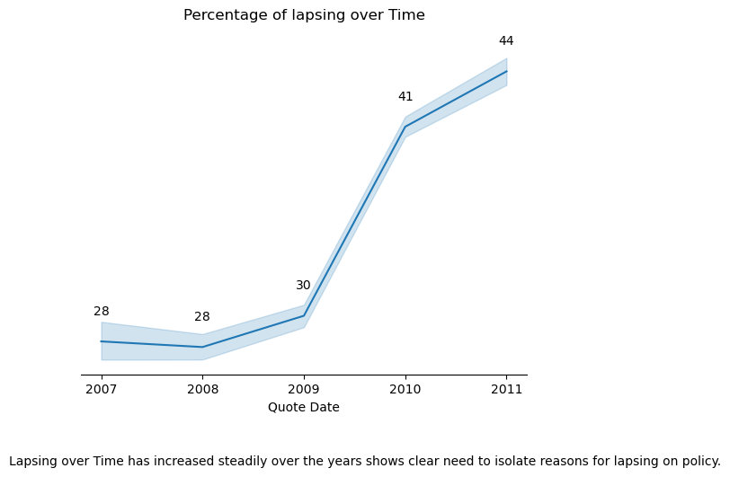
Why Bother?
* Policy Quote Value may allow us to see losses over time too, but this information was not available
Notes:
Another interesting aspect is the overall increase in proportion of lapsing between 2007 - 2012. In a future analysis I would look to isolate the last years lapsing which was at a proportion of ~40%.

Slide 3
TABLE OF CONTENTS
01
02
03
Cleansing
The PROCESS
Conclusion
An initial look at the dataset
Discussion Around EDA and Model Strategy
What were the findings?

Slide 4
Cleansing Steps
Dataset
By looking at distributions of each field I made a few changes…
- Quantile Grouping and creation of categorical columns from continuous data where distribution is heavily skewed (this helps to remove outliers) EG roof construction score
- Some columns assumed ordinal not continuous EG NCD years and bedroom counts
- 256136 records
- Duplicate Removal 191015 records left
- Ensure datetime values
- Remaining nulls had no cover start date and much of the other information was missing so they were removed
- Dropping MTA extras for initial phase but leaving the MTA flag
- Dropping ID cols and other Cols with high percentage of nulls where imputation doesn’t make sense
- Imputation of the median for risk areas due to non-normal distribution

Slide 5

EDA
Strategy:
1) The fields were split into their data types (Bool, Ordinal, Nominal, Continuous).
2) The particular field was compared to the target variable (‘has_lapsed’)
3) If the field was continuous, a Kruskal-Wallis test or Man-Whitney U test was conducted with a bar chart to visualise the difference.
4) Categorical fields were tested with a chi squared test and Cramers V score to test the association strength with either Bar charts or Heatmaps to visualise.

Slide 6
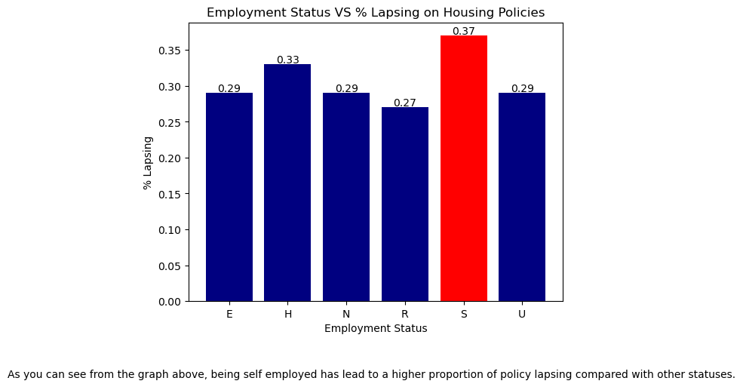
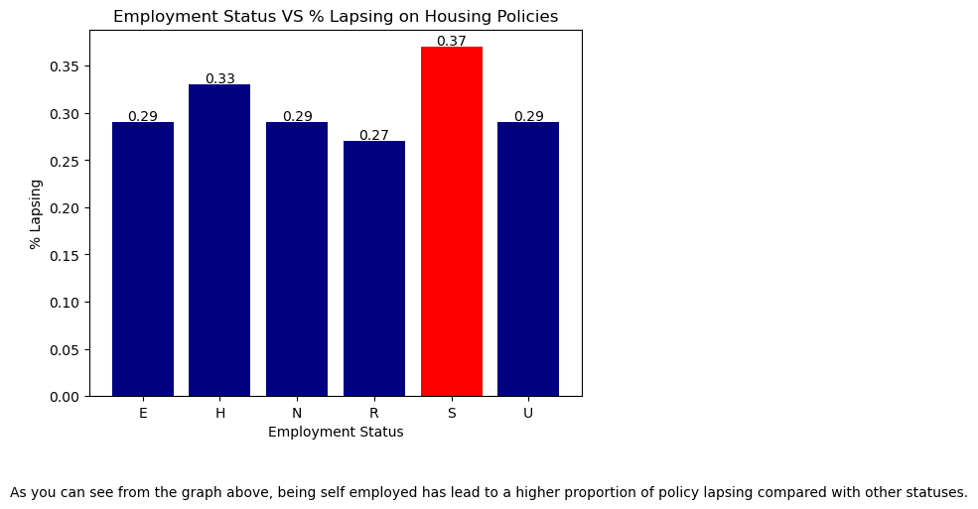
EDA Findings
1) Employment Status
Self-employment can be associated with a variable and often unpredictable income stream.
This may lead to difficulties in meeting financial obligations, including insurance premium payments.
Difficulties in keeping track of payments and deadlines.
Don’t have access to the same benefits and support systems as those who are employed by a company.

Slide 7
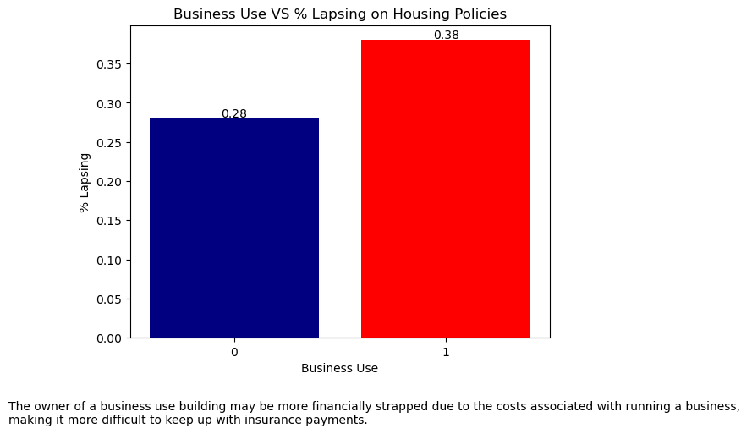
EDA Findings
2) Business Use
*Including data about the market performance at the time would be useful here

Slide 8
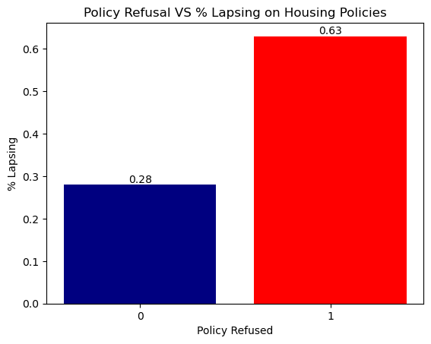
EDA Findings
3) Policy Refusal
"P1_POLICY_REFUSED" indicates whether the policy was refused in the past or not.
Indicator of a higher risk profile or has a history of non-compliance with insurance policies.
Additionally, if an individual has been refused coverage in the past, they may have a harder time finding affordable coverage, which could lead to lapses in coverage due to financial difficulties.

Slide 9
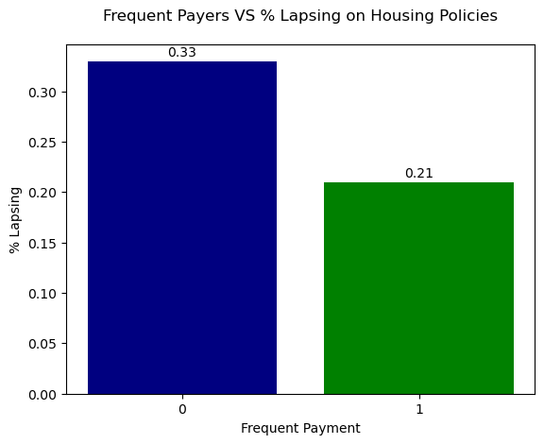
EDA Findings
4) Payment Frequency
Why?
1) Cash flow Management
2) Budgeting
3) Lack of Reminders
Notes:
PAYMENT_FREQUENCY could have an effect on lapsing for the following reasons:
Cash flow management: If the policy holder is paying on a less frequent basis, such as annually or biannually, they may need to manage their cash flow more carefully. If an unexpected expense arises, they may prioritize paying for that expense over their insurance premium.
Budgeting: Policy holders who pay less frequently may not have the same level of budgeting and financial planning skills as those who pay more frequently. They may not have as clear of a picture of their income and expenses, which could make it easier to miss a premium payment.
Lack of reminders: Policy holders who pay less frequently may not receive as many reminders about their premium payments. If they forget when their payment is due, they may miss the deadline and risk their policy lapsing.

Slide 10
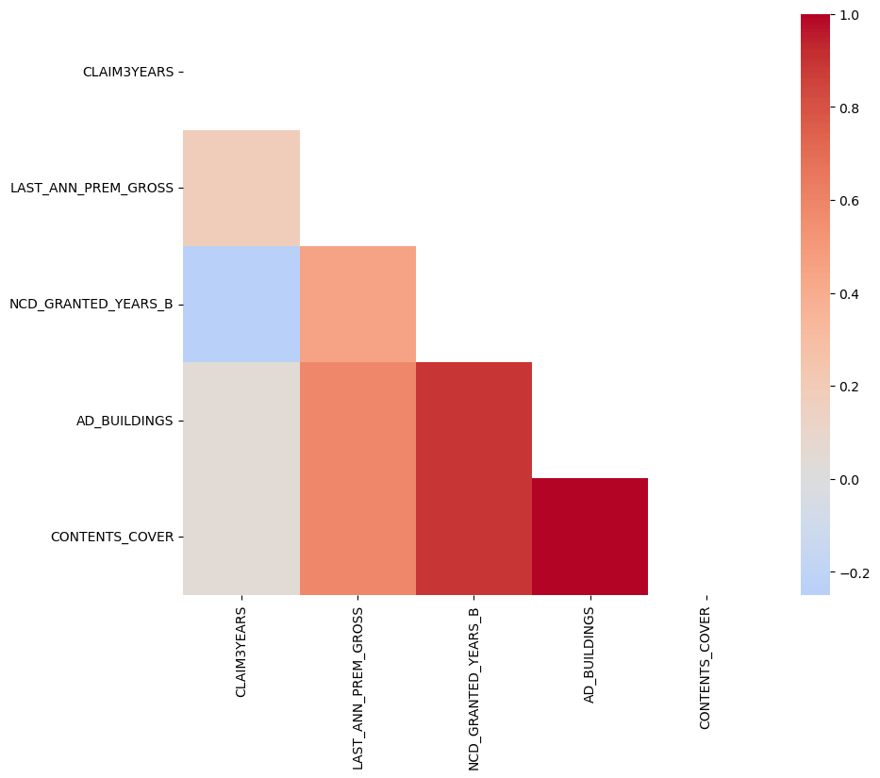
EDA Findings
5) Interesting Correlations
A) 3 Year Claim with Last years premium payments
2) NCD Granted years and Building/Contents Cover
3) Building Cover with Contents Cover
Notes:
A) 3 Year Claim with Last years premium payments
why?
High premium payments: Customers who pay higher premiums may have higher claim amounts because they have more valuable assets to protect or they may be more likely to file a claim due to the higher investment they have made.
More coverage: Customers who opt for higher coverage may pay higher premiums and therefore, have higher claim amounts.
Previous claims history: Customers who have a history of making claims in the past may be charged higher premiums and also be more likely to make a claim in the future.
Market trends: Changes in the market can lead to an increase in both premiums and claims, resulting in a positive correlation between the two variables.
B) NCD Granted years and Building/Contents cover positive correlation
why?
Individuals who have a higher NCD (no-claims discount) may also have a greater sense of responsibility and be more likely to insure their properties. C) AD_BUILDINGS + CONTENTS_COVER
why?
1. policies that provide comprehensive coverage for a home often include both building coverage and personal belongings coverage.
These two values were also an indication of lapsing in the charts at the EDA stage. This could be due to:
Cost: AD_BUILDINGS and CONTENTS_COVER may be more expensive, and therefore customers may be more likely to let their policy lapse to save money.
Risk: AD_BUILDINGS and CONTENTS_COVER may be more associated with risk, such as living in areas prone to natural disasters or crime, and therefore customers may be more likely to let their policy lapse if they perceive the risk to be low (Although our dataset does not show this is the case).

Slide 11

Pre-processing & MODELLING

Slide 12
Preprocessing
Strategy:
1) Ordinal Features left alone
2) Nominal Features undergo Onehot Encoding
3) Continuous Features were Standard Scaled (in future iterations a robust scaler may be more appropriate to combat outliers)
4) Ensure Boolean features either 0 or 1
Notes:
NB – Baseline accuracy is 0.722

Slide 13
MODELLING
Strategy:
1) Classification Models, specifically Logistic Regression, Decisions trees, Random Forests.
2) The coefficients/importance of the fields give indication of association strength with lapsing.
3) Gridsearch can be used to optimise the model performance and prevent overfitting of the model to the training data.
4) In the case of poor model performance, bootstrapping the model training and finding the 2.5%/97.5% quantiles give an indication of importance (if 0 is not in the range!)
5) Baseline is 0.722; SMOTENC can be used to oversample the minority class (lapsing)
Notes:
NB – Baseline accuracy is 0.722

Slide 14
Modelling
Model | Accuracy | Precision | Recall | F1 Score | AUC Score
Logistic Regression | 0.724 | 0.566 | 0.033 | 0.063 | 0.651
Random Forest | 0.726 | 0.820 | 0.019 | 0.037 | 0.676
Decision Tree | 0.732 | 0.839 | 0.042 | 0.080 | 0.666
XGBoost | 0.740 | 0.624 | 0.164 | 0.260 | 0.699
Although the models are poor predictors of lapsing, they perform marginally better than the baseline which means some features are indicators of lapsing

Slide 15
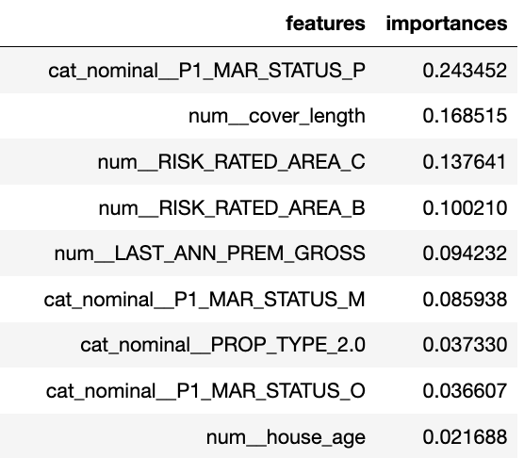
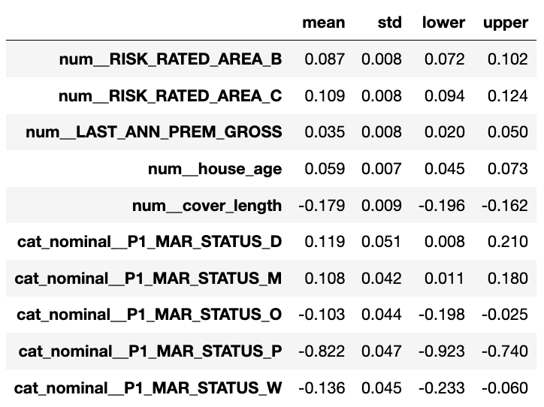
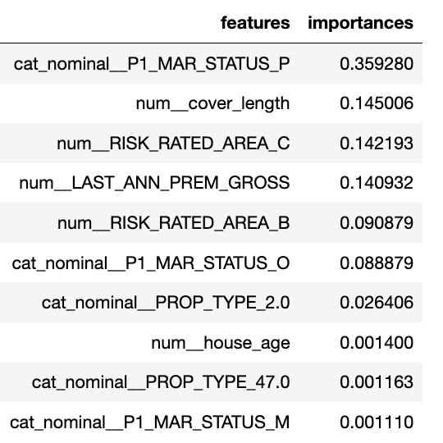
Feature Importance and Coefficients
Random Forest
Logistic Regression
Decision Tree

Slide 16
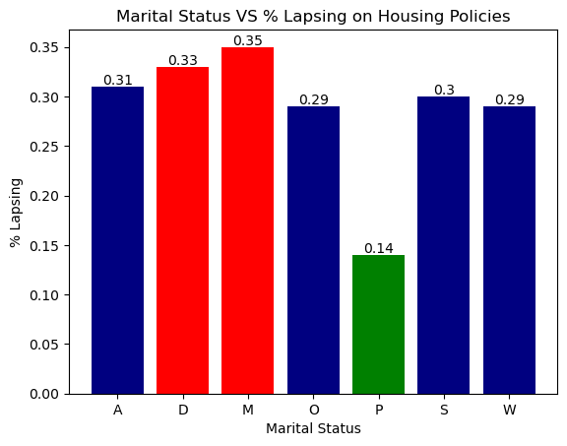
Modelling Findings
1) Marital Status
Why Partnerships could be an indication of lapsing:
1) Financial Stability
2) Risk Aversion
3) Social Support
Notes:
According to the model, being Divorced/Married meant that the individual had a log odds increase. Here is the proportionality of those categories with Lapsing.
# The biggest indicator of lapsing, however, is NOT being in a partnership. Potential reasons for this are:
# 1. Financial Stability: Partnerships may have more financial stability and resources than those who are single or divorced, and therefore may be less likely to experience financial difficulties or miss payments.
# 2. Risk Aversion: Partnerships may be more risk-averse and cautious than those who are single, which could lead to more responsible financial behavior.
# 3. Social Support: Marriage or partnership can provide social support and a safety net in times of financial difficulty, which may reduce the likelihood of policy lapses.''')

Slide 17
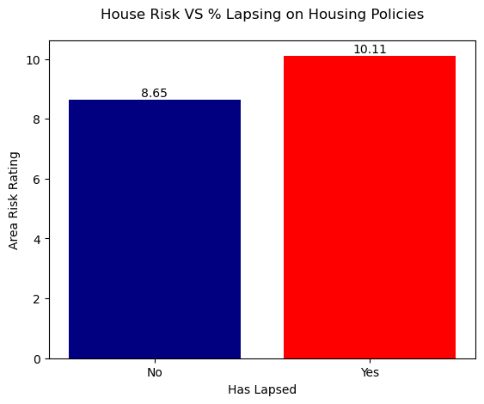
Modelling Findings
2) House Risk
High Risk Areas could mean: 1) Financial Difficulties 2) More likely to seek insurance coverage
Notes:
If RISK_RATED_AREA_C is a strong indicator for lapsing on a housing policy, it may suggest that policyholders living in areas with higher levels of risk may be more likely to experience financial difficulties or other issues that could lead to missed payments or policy lapses. Alternatively, it is also possible that policyholders in areas with higher risk may be more likely to seek out insurance coverage and thus have a higher propensity for purchasing a home insurance policy in the first place, resulting in a higher number of lapses as well. Unfortunately, we dont have the income of the policy holders and so we cant gauge the effect this has on lapsing.

Slide 18
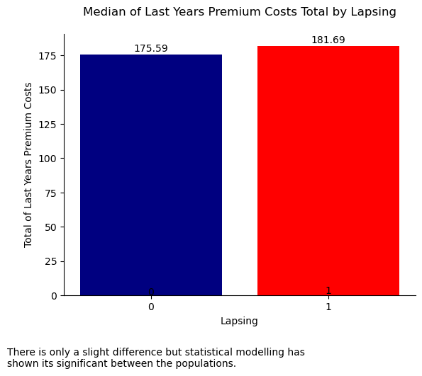
Modelling Findings
3) Last Years Premium Costs
Median Cost 3.5% higher for Lapsers
Why could this be an issue? 1) Affordability 2) Higher Premiums = More Comprehensive Coverage
3) Competition
Notes:
Affordability: Higher premium payments may strain a policyholder's finances, making it more difficult for them to make payments on time or at all.
Risk: Policyholders with higher premiums may be more likely to live in high-risk areas or have higher-valued properties, which could increase the likelihood of a claim being made and therefore the likelihood of lapsing.
Coverage: It's possible that policyholders with higher premiums are more likely to have more comprehensive coverage, which could lead to a higher likelihood of claims being made and therefore the likelihood of lapsing.
Competition: Higher premium policies may be more expensive relative to other policies on the market, leading to policyholders shopping around for cheaper alternatives and ultimately lapsing on their current policy.

Slide 19
Final Thought
I would suggest the insurance company look to insure non-business owners, who have a partner and live in low-risk areas.
Furthermore, if these individuals do not have a history of lapsing and are able to frequently pay their policy quotes they are of lower risk for future lapses.

Slide 20
ANY QUESTIONS?

